Slide 1
Land Valuation Concepts
Doug Bruns, SAMA
Deputy Renville County Assessor
Renville County Assessors Office
Ph:(320)523-3644
Email: doug_b@co.renville.mn.us

Slide 2
Renville County
Renville County Characteristics
Approx 640,000 acres in size
Approx 88% tillable Farmland
Highly Productive Soils
Main crops include corn, soybeans, sugar beets, edible beans, peas & sweet corn.

Slide 3
Land Valuation
Renville County Land Values
Cash Rents still exceeding $400/acre
May be starting to trend down
New rent contracts $300/acre or less
Land sales still exceeding $10,000/ac
Currently 37 bare land sales with a median sale price of $10,256/till ac
# of sales is down and less productive land is selling for less
Is the market softening?

Slide 4
Land Valuation
When a tract of land is sold, there may or may not be things that affect the sale price.
Some common factors:
Soil Productivity

Slide 6
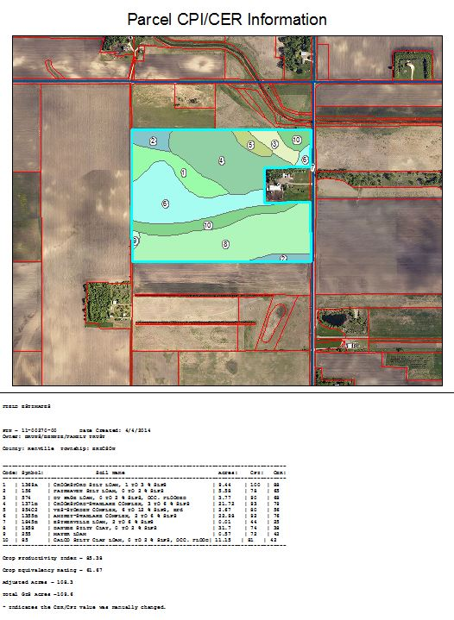

Slide 7
Land Valuation
When a tract of land is sold, there may or may not be things that affect the sale price.
Some common factors:
Soil Productivity
Drainage

Slide 8
Land Valuation
Drainage
Private tile
Pattern tile – what is adequate?
Anywhere from 35’ apart

Slide 11
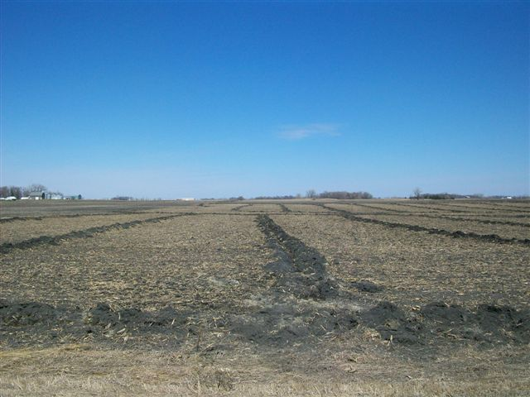

Slide 12
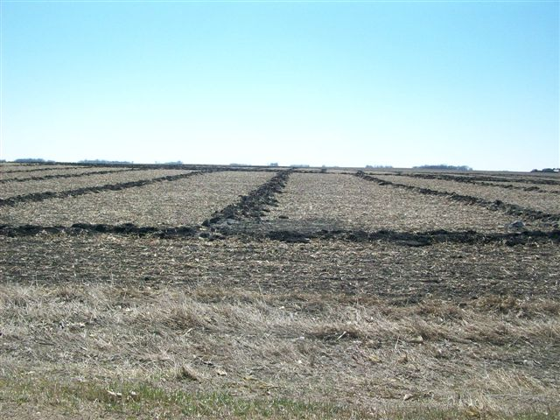

Slide 16
Land Valuation
Drainage
Private tile
Pattern tile – what is adequate?
Anywhere from 35’ apart
County Tile
Quality and Capacity

Slide 17
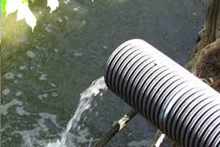

Slide 18
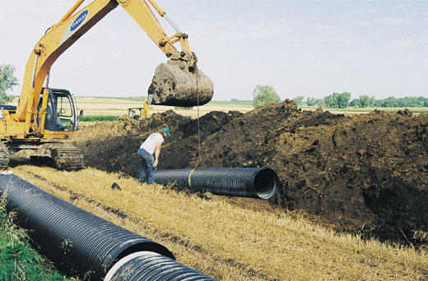

Slide 19
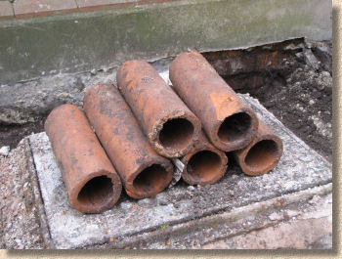

Slide 20
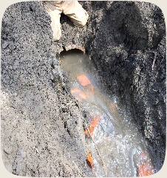

Slide 21
Land Valuation
Drainage
Private tile
Pattern tile – what is adequate?
Anywhere from 35’ apart
County Tile
Quality and Capacity
Ditches/Creeks

Slide 22
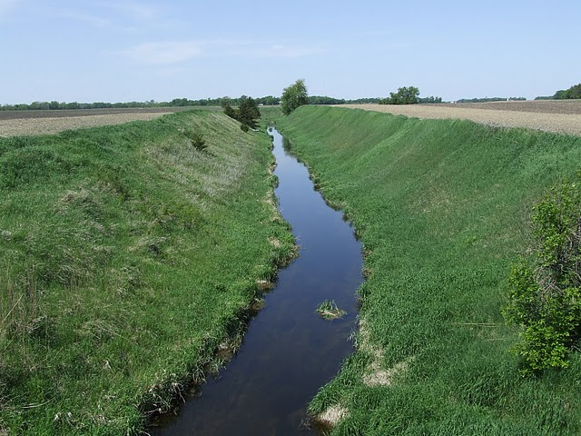

Slide 23
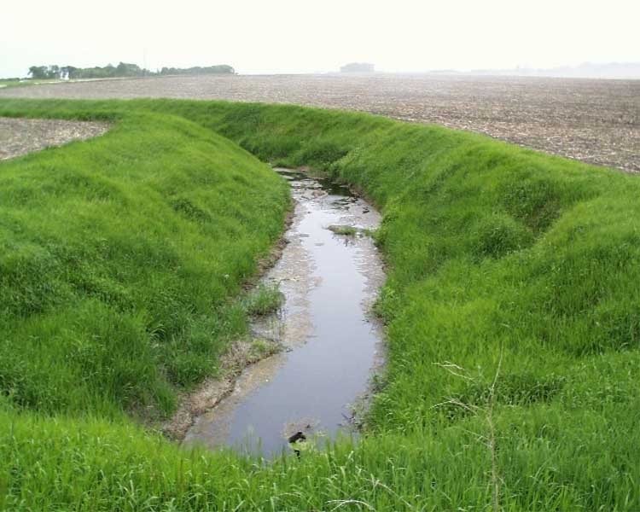

Slide 24
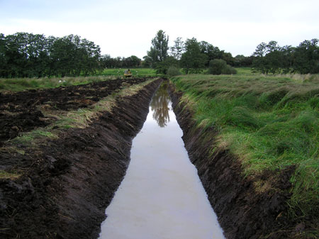

Slide 25
Land Valuation
When a tract of land is sold, there may or may not be things that affect the sale price.
Some common factors:
Soil Productivity
Drainage
Field arrangement

Slide 26
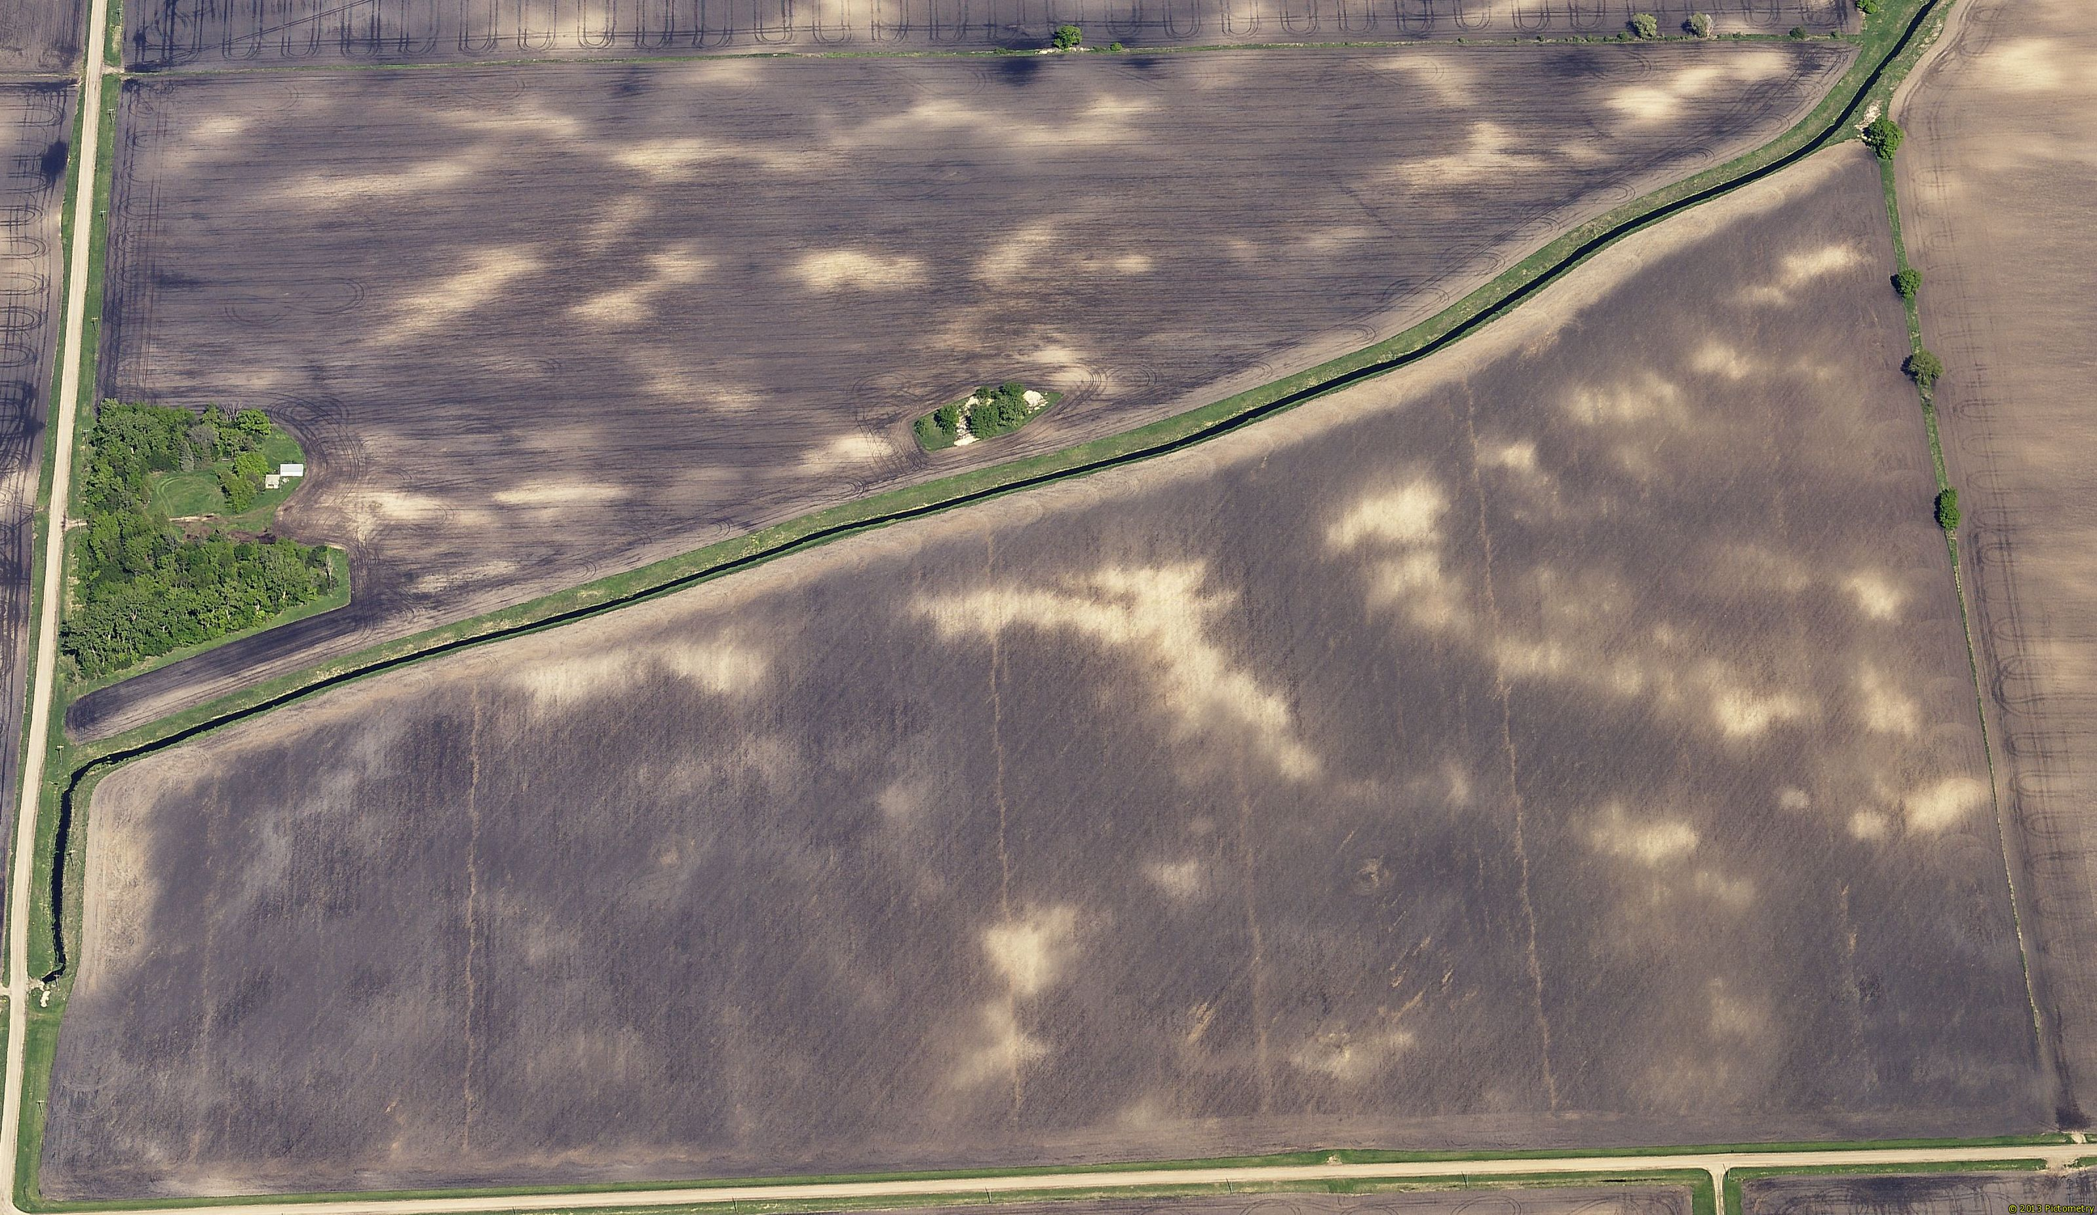

Slide 27
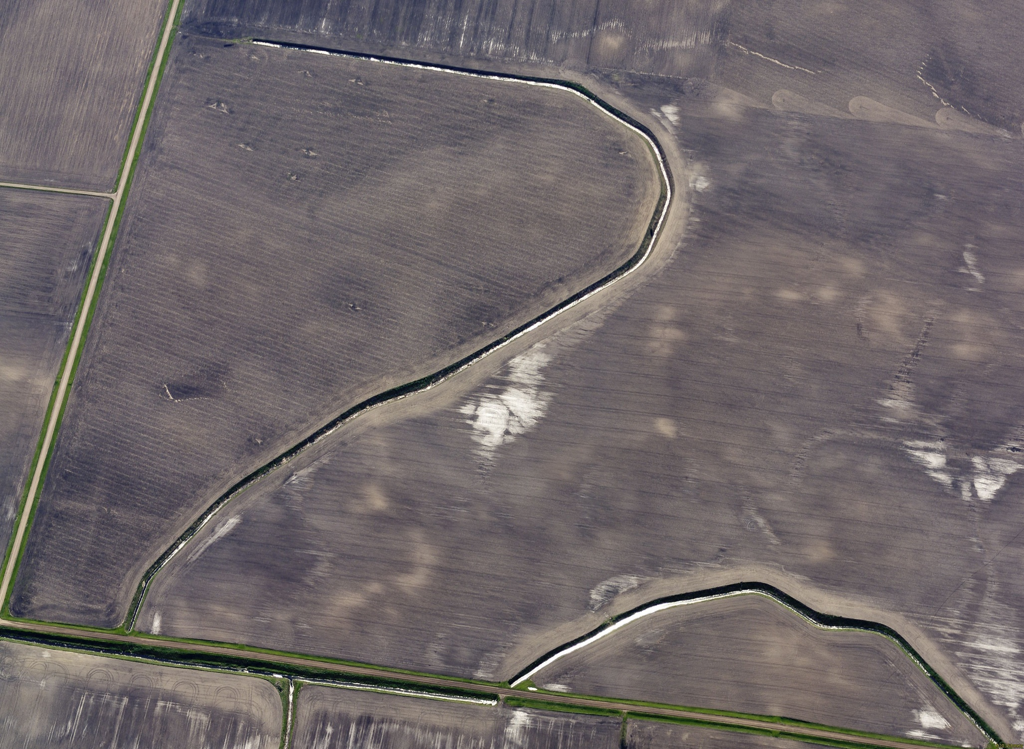

Slide 28
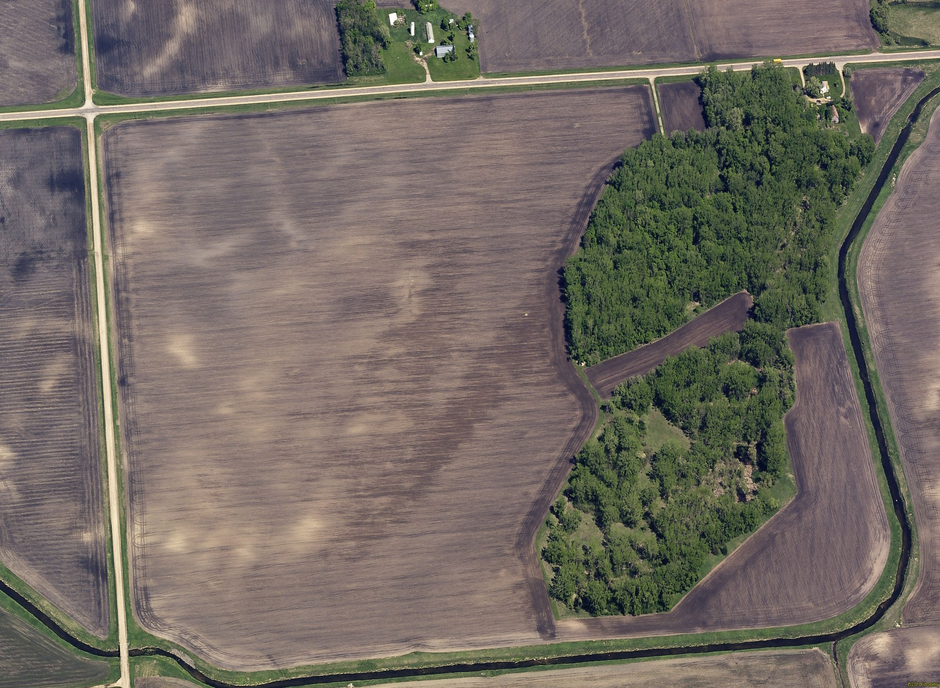

Slide 29
Land Valuation
When a tract of land is sold, there may or may not be things that affect the sale price.
Some common factors:
Soil Productivity
Drainage
Field arrangement
Lack of Drainage capabilities (no outlet for drainage)

Slide 30
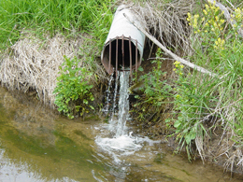

Slide 31
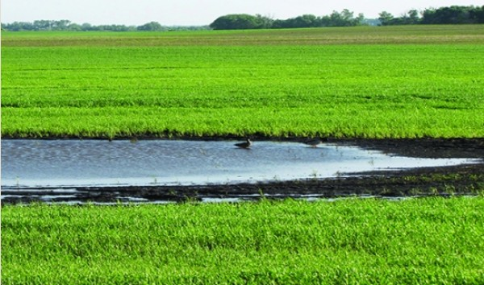

Slide 32
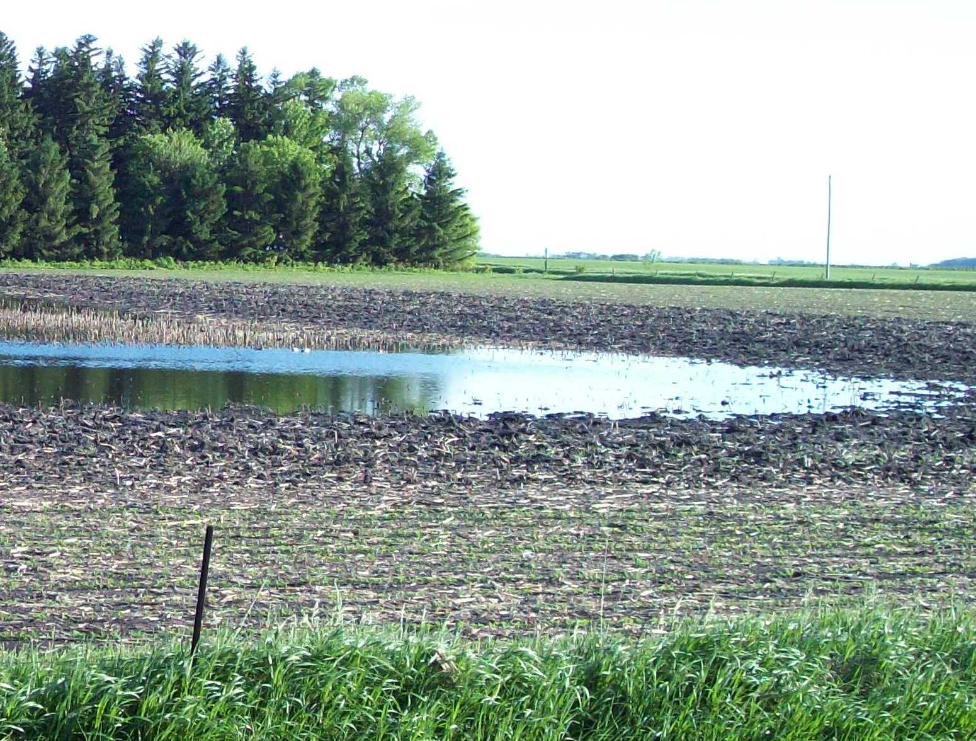

Slide 33
Land Valuation
When a tract of land is sold, there may or may not be things that affect the sale price.
Some common factors:
Soil Productivity
Drainage
Field arrangement
Lack of Drainage capabilities (no outlet for drainage)
Easements (both temporary and perpetual)

Slide 34
Land Valuation
Easements
Types that may affect market value
CRP – Conservation Reserve Program
Most common type is 15 year easement
Perpetual Easements
RIM – Reinvest in Minnesota
CREP – Conservation Reserve Enhancement Program
WRP – Wetland Reserve Program
Native Prairie Easement
Many others

Slide 35
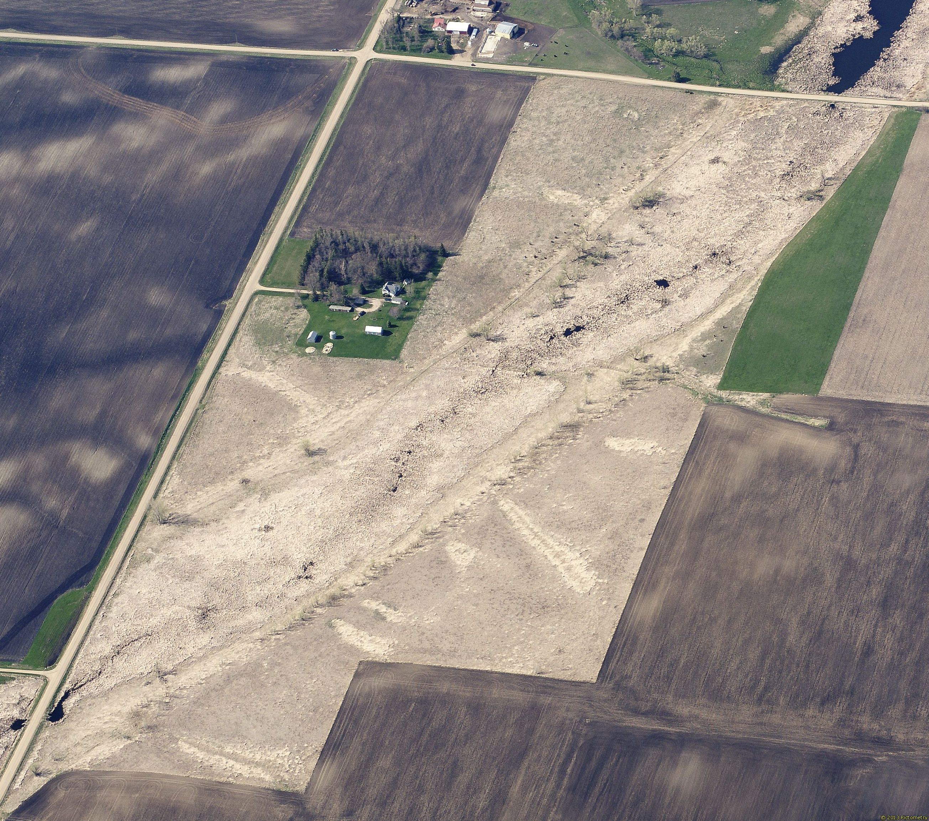

Slide 36
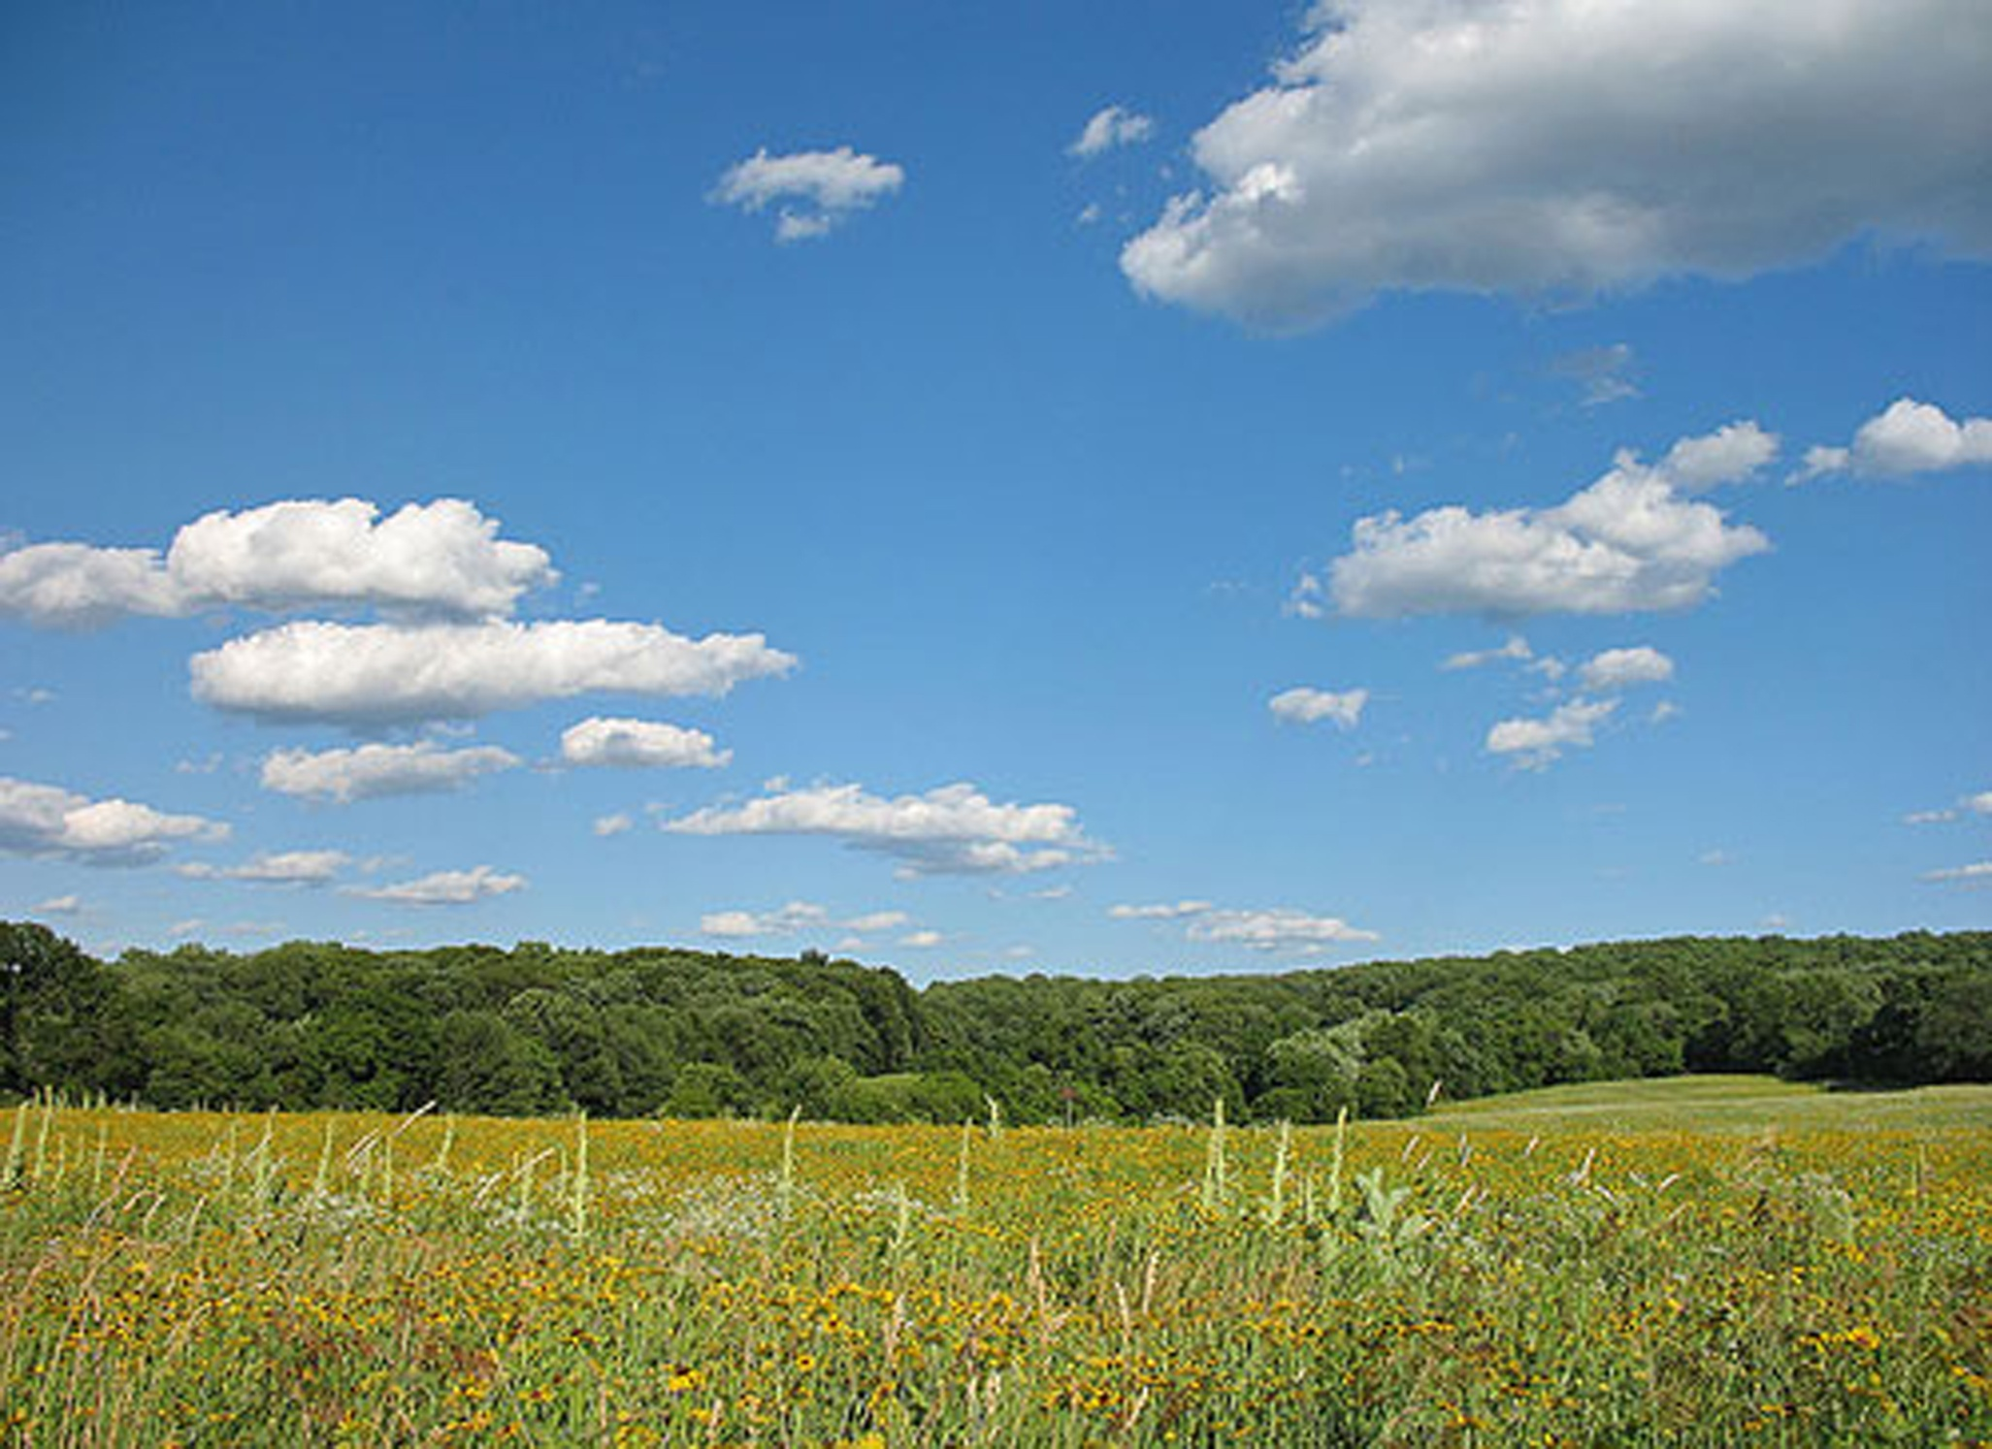

Slide 37
Land Valuation
When a tract of land is sold, there may or may not be things that affect the sale price.
Some common factors:
Soil Productivity
Drainage
Field arrangement
Lack of Drainage capabilities (no outlet for drainage)
Easements (both temporary and perpetual)
Location/Access

Slide 38
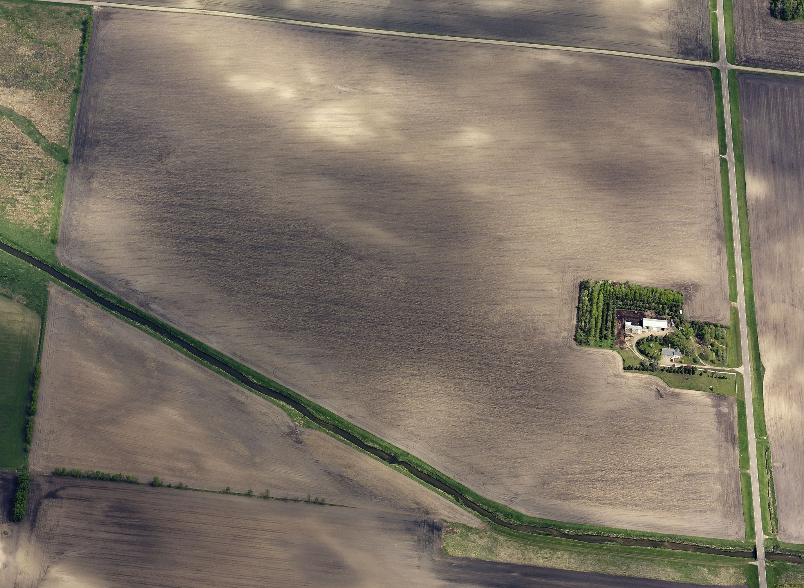
Field Entrance

Slide 39
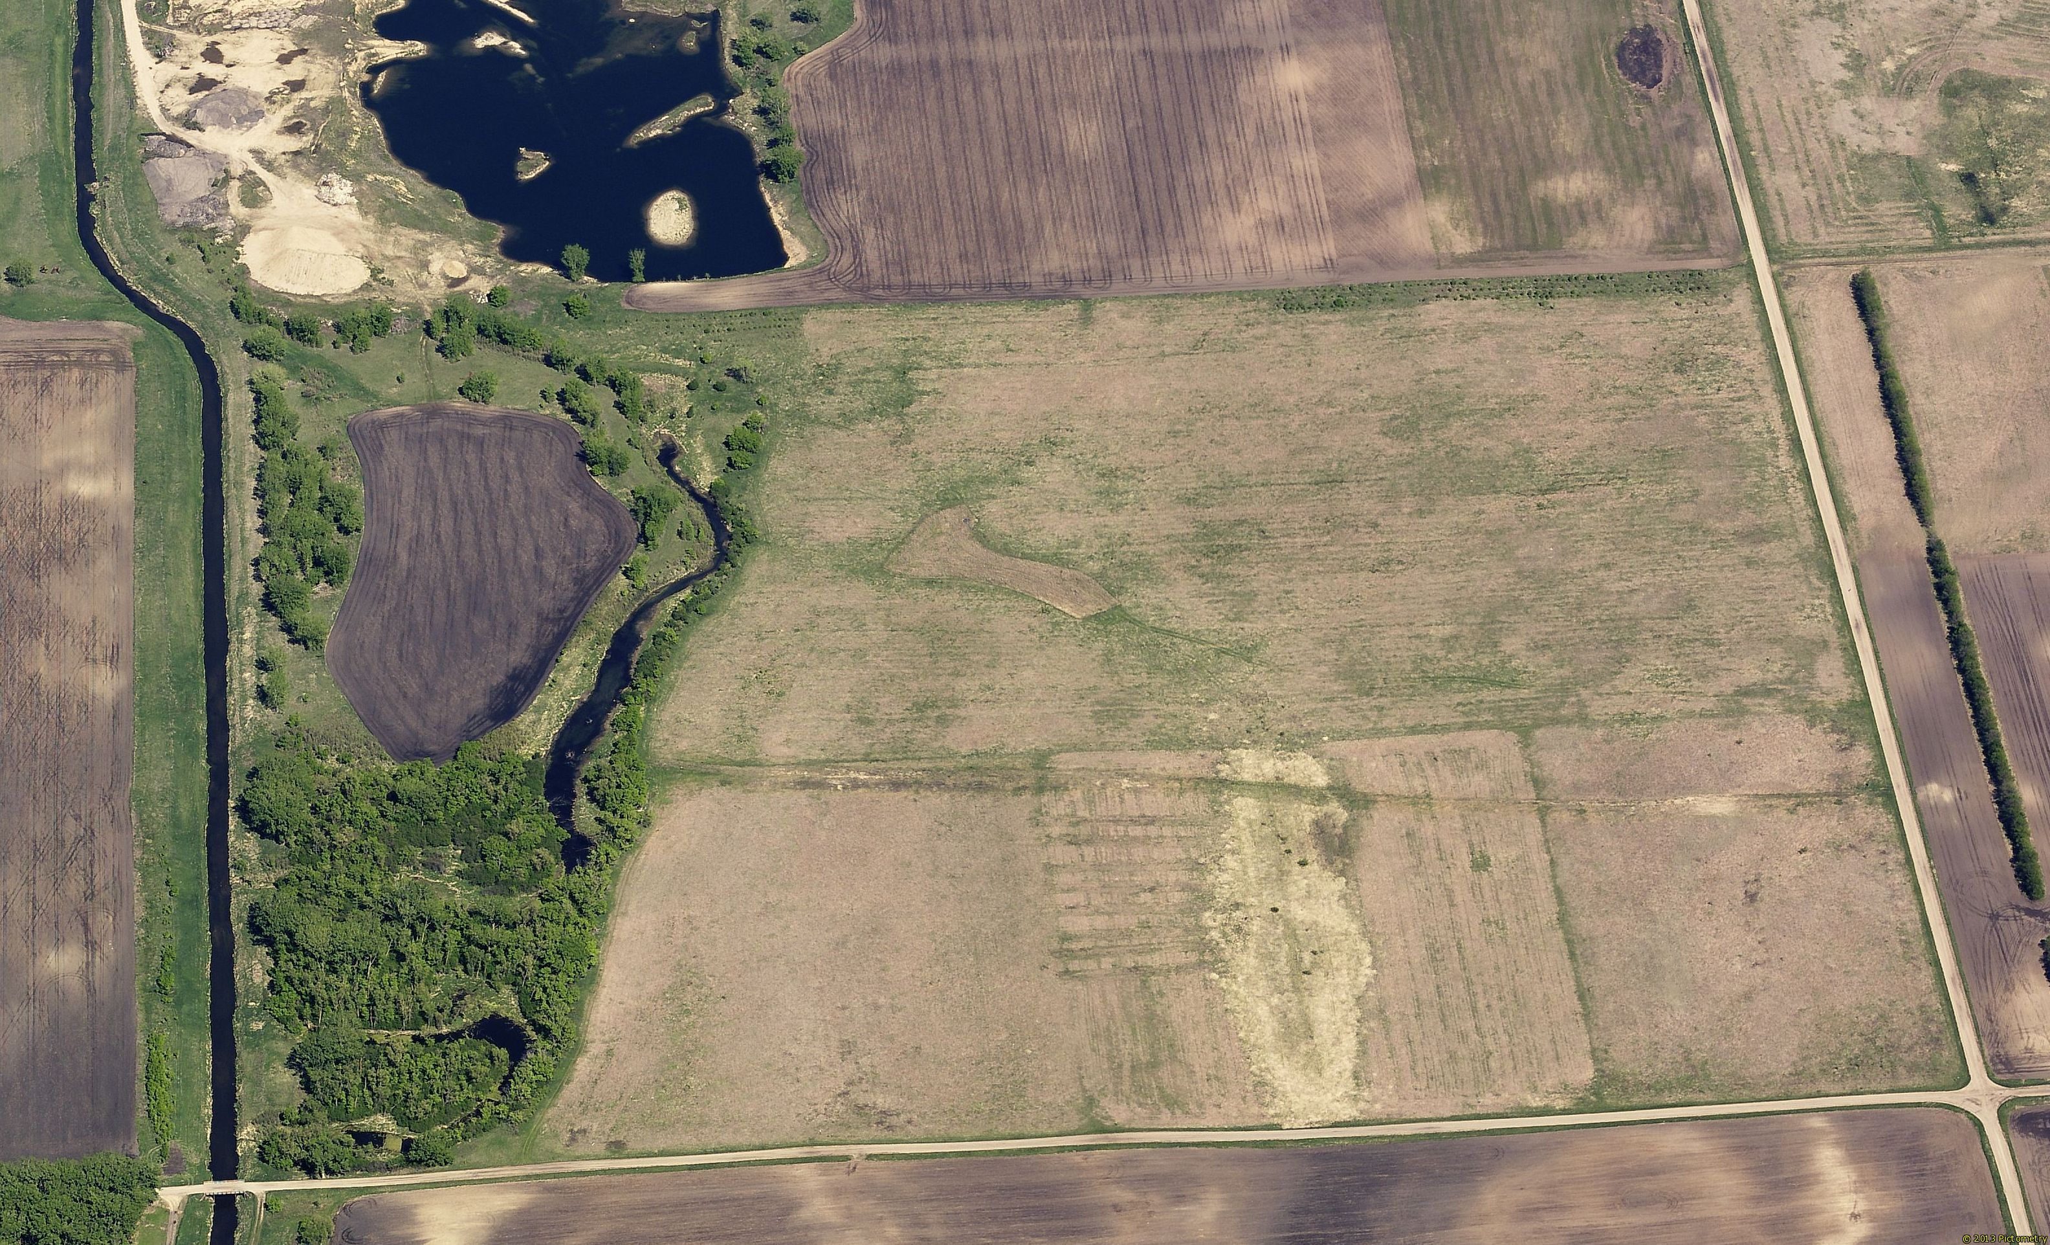
Field Entrance

Slide 40
Land Valuation
When a tract of land is sold, there may or may not be things that affect the sale price.
Some common factors:
Soil Productivity
Drainage
Field arrangement
Lack of Drainage capabilities (no outlet for drainage)
Easements (both temporary and perpetual)
Location/Access
Irrigation

Slide 41
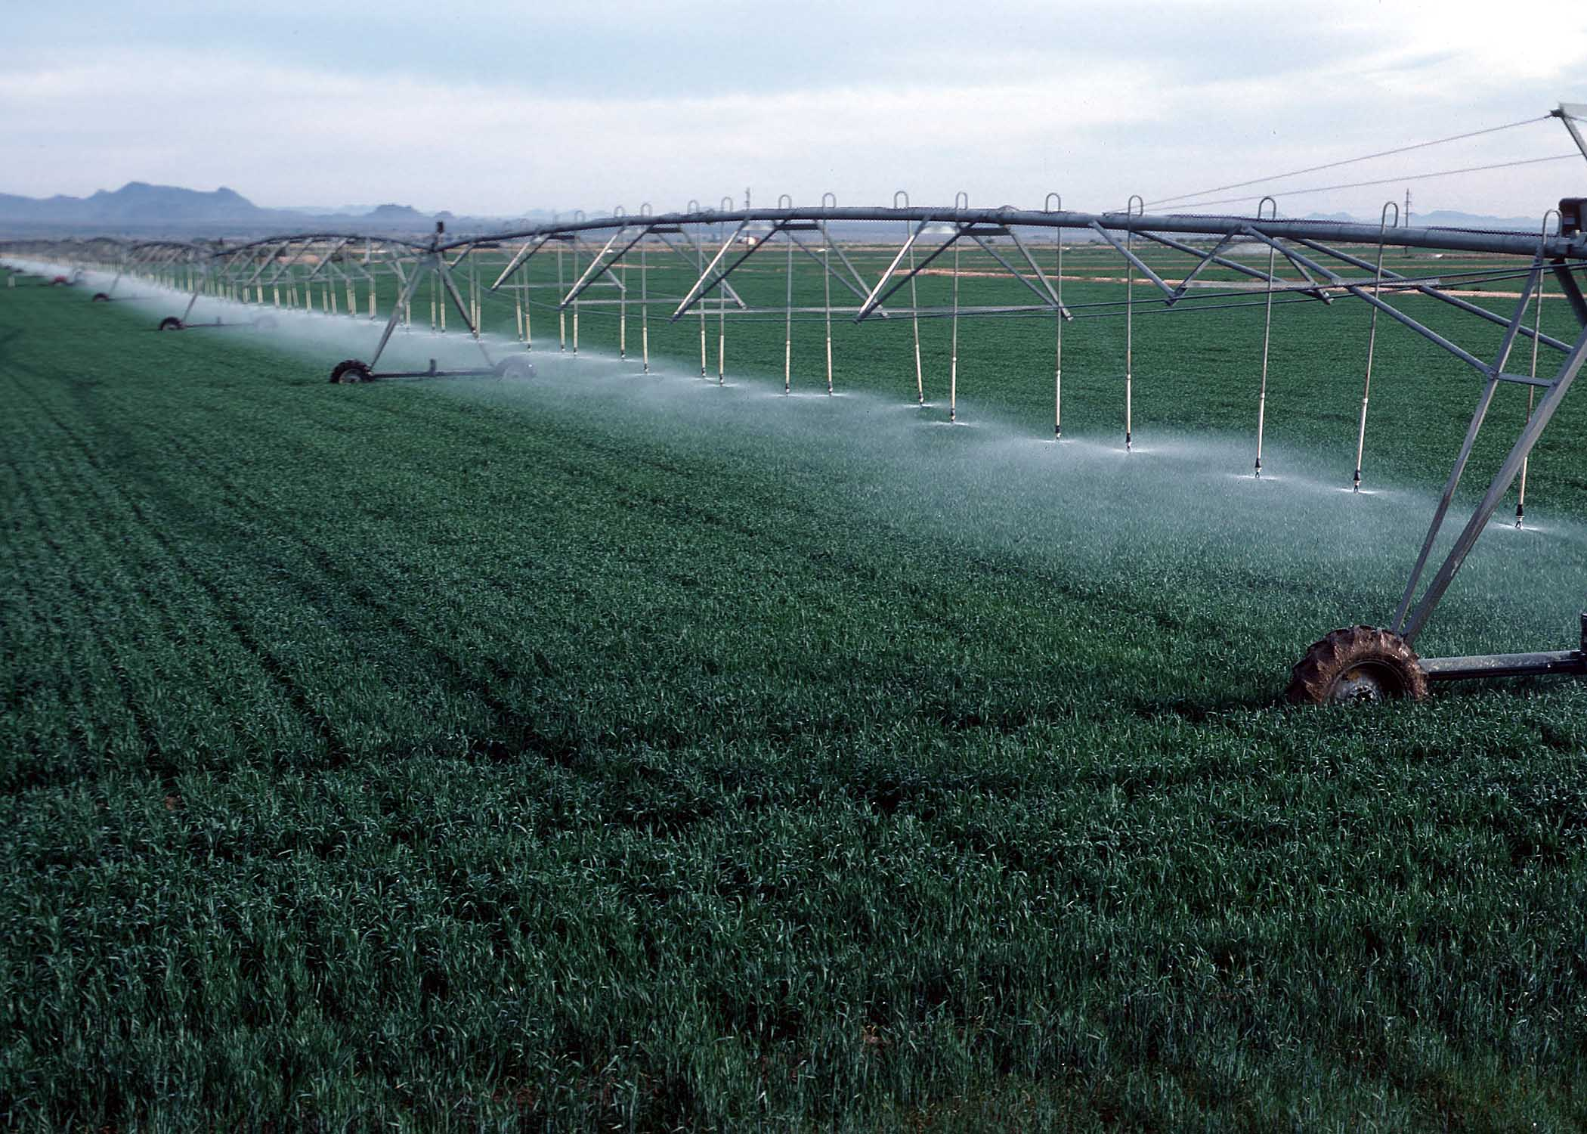

Slide 42
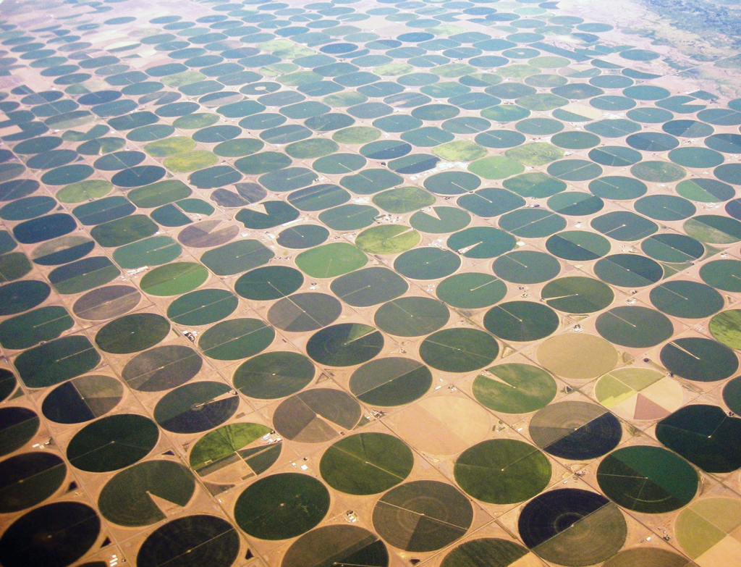

Slide 43
Land Valuation
When a tract of land is sold, there may or may not be things that affect the sale price.
Some common factors:
Soil Productivity
Drainage
Field arrangement
Lack of Drainage capabilities (no outlet for drainage)
Easements (both temporary and perpetual)
Location/Access
Irrigation
Zoning Requirements/Restrictions
Others???

Slide 44
Land Valuation
Common Valuation methods
CER – Reflects a level of management in its rating, not purely related to the soil.
CPI – is purely based on raw productivity of the soil
Till Value – simply an average tillable value per acre
ABC – Grouping of highly productive acres and less productive acres within a parcel
Combination of one or more methods
Others?

Slide 45
Land Valuation
Common Valuation methods
CER – Reflects a level of management in its rating, not purely related to the soil.
Example:
- Sale Price = $9,750 per till acre w/ CER of 75.00
Indicated sale price per CER = 130.00 (indicated mult.)
- Subject Property = CER of 68.00
Indicated value is $8,840/till ac (using indicated mult.)

Slide 46
Land Valuation
Common Valuation methods
CPI – is purely based on raw productivity of the soil
Example:
- Sale Price = $9,750 per till acre w/ CPI of 91.98
Indicated sale price per CPI = 106.00 (indicated mult.)
- Subject Property = CPI of 93.25
Indicated value is $9,885/till ac (using indicated mult.)

Slide 47
Land Valuation
Common Valuation methods
ABC – Grouping of highly productive acres and less productive acres within a parcel
Example:
- Sale #1 = $7,000 per till acre w/ all “C” marginal soils/land type
- Sale #2 = $8,000 per till acre w/ all “B” average soils/land type
- Sale #3 = $9,000 per till acre w/ all “A” good soils/land type
- Subject Property = 75 tillable acres total
25 acres of “A” 25.00 x 9,000 = 225,000
25 acres of “B” 25.00 x 8,000 = 200,000
25 acres of “C” 25.00 x 7,000 = 175,000
Total = 600,000
Indicated value is $8,000/till ac

Slide 48
Land Valuation
Common Valuation methods
Combination of one or more methods
Examples:
- Using CER ranges for determining A B C values
- Using CPI ranges for determining A B C values
- Others?

Slide 49
Helpful Resources available:
Agricultural Classification
MAAO website – Department of Revenue Letters Manual
http://www.mnmaao.org/
Department of Revenue Property Tax Administrator’s Manual
http://www.revenue.state.mn.us/local_gov/prop_tax_admin/Pages/ptamanual.aspx
MAAO Ag Committee Members
Neighboring county assessor offices
Agricultural Buildings
Marshall & Swift Cost Manual
Local contractors
Local independent appraisal firms
Neighboring county assessor offices
MAAO Grain Elevator Cost Schedule
Agricultural Land
Agricultural Publications & Web Sites:
Upper Midwest Management – North Central News
http://www.ummc.co
USDA National Agricultural Statistics Service
http://www.nass.usda.gov/Surveys/Guide_to_NASS_Surveys/Agricultural_Economics_and_Land_Ownership/index.asp
Minnesota Land Economics
www.landeconomics.umn.edu,
LandAndFarm – search land for sale
www.landandfarm.com/search/Minnesota-Farm-for-sale
Multiple Listing Service MLS
Local independent appraisal firms
Cross county agricultural values
Area farmer information
Corporate Farm Lookup
http://www2.mda.state.mn.us/webapp/lis/corpfarm_default.jsp
Lists entities registered with the Minnesota Department of Agriculture per
MN Statute 500.24

Slide 50
Helpful Resources available:
Minnesota Association of Soil and Water Conservation Districts
http://www.maswcd.org/
Minnesota Association of Consulting Foresters
http://web.paulbunyan.net/norfor/
Provides the names and contact information of members registered to write a forest management plan for the 2c Managed Forest Classification
Minnesota Board of Water and Soil Resources
http://www.bwsr.state.mn.us/
Wetland Delineation
Conservation Easements
RIM
Minnesota Department of Agriculture
https://www.mda.state.mn.us/
Minnesota Department of Revenue
http://www.revenue.state.mn.us
Minnesota Land Trust
http://www.mnland.org/
Reviser of Statutes
www.revisor.leg.state.mn.us/statutes/
USDA – National Agricultural Statistics Service
http://www.nass.usda.gov/Statistics_by_State/Minnesota/index.asp
MAAO Agricultural Committee Members
Jeanne Henderson, Sherburne County, Chair Keith Kern, Carver County, Region 9, Vice-Chair
Ron Vikre, Fillmore County, Region 1 Sue Schulz, McLeod County, Region 2
Mark Koehn, Stearns County, Region 3 Mike Dangers, Aitkin County, Region 4
Joyce Schmidt, Pipestone County, Region 5 Doug Bruns, Renville County, Region 6
Steve Carlson, Becker County, Region 7 Al Heim, Roseau County, Region 8
Tom Reineke, DOR Representative

Slide 51
Questions???

